Slide 1
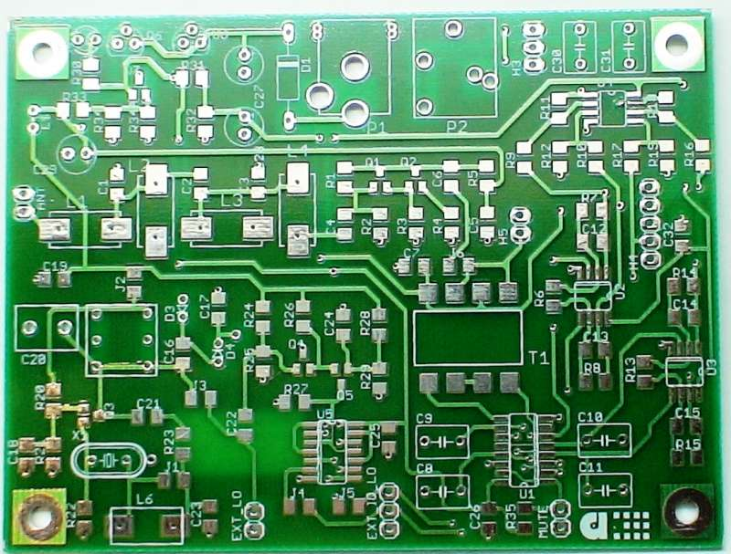
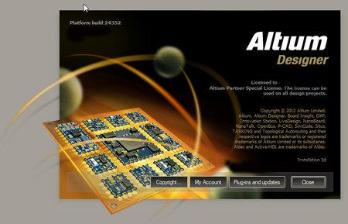
WORKSHOP ON PCB DESIGNING
WITH ALTIUM

Slide 2
What is PCB
Printed Circuit Board
Electronic Board that connects circuit components
PCB populated with electronic components is a printed circuit assembly (PCA)
PCBs are rugged, inexpensive, and can be highly reliable
Mass manufacturing
Professional

Slide 3
Materials of PCB
Conducting layers are typically made of thin copper foil.
The board is typically coated with a solder mask that is green in color. Other colors that are normally available are blue and red.
Unwanted copper is removed from the substrate after etching leaving only the desired copper traces or pathways

Slide 4
Parts of a PCB
Components
Pads
Traces
Vias
Top Metal Layer
Bottom Metal Layer

Slide 5
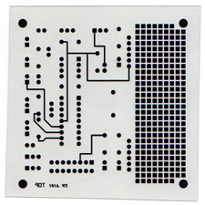
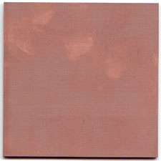
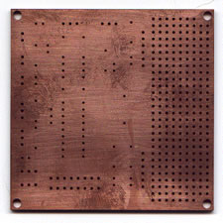
Steps in PCB design
Film Generation
2. Shear Raw Material
3. Drill Holes
Industry standard 0.059" thick, copper clad, two sides

Slide 6
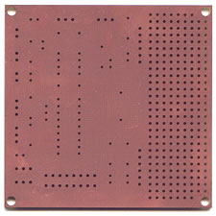
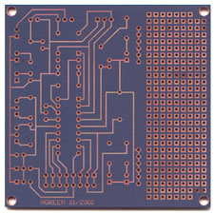
Steps in PCB design
4. Electrolus copper
5. Apply Image
Apply copper in hole barrels
Apply Photosensitive Material to develop selected areas from panel

Slide 7
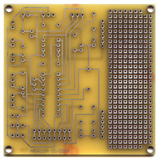
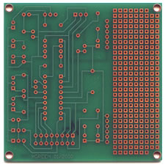
Steps in PCB Design
6. Strip and Etch
7. Solder Mask
Remove dryfilm, then etch exposed copper
Tin protects the copper circuitry from being etched
Apply solder mask area to entire board with the exception of solder pads

Slide 8
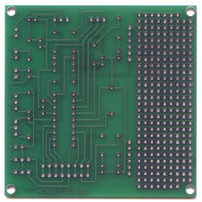
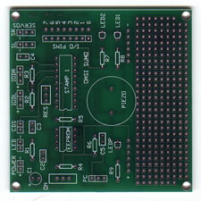
Steps in PCB Design
8. Solder Coat
9. Silkscreen
Apply solder to pads
Apply white letter marking using screen printing process

Slide 9
INTRODUCTION TO ALTIUM DESIGNER

Slide 10
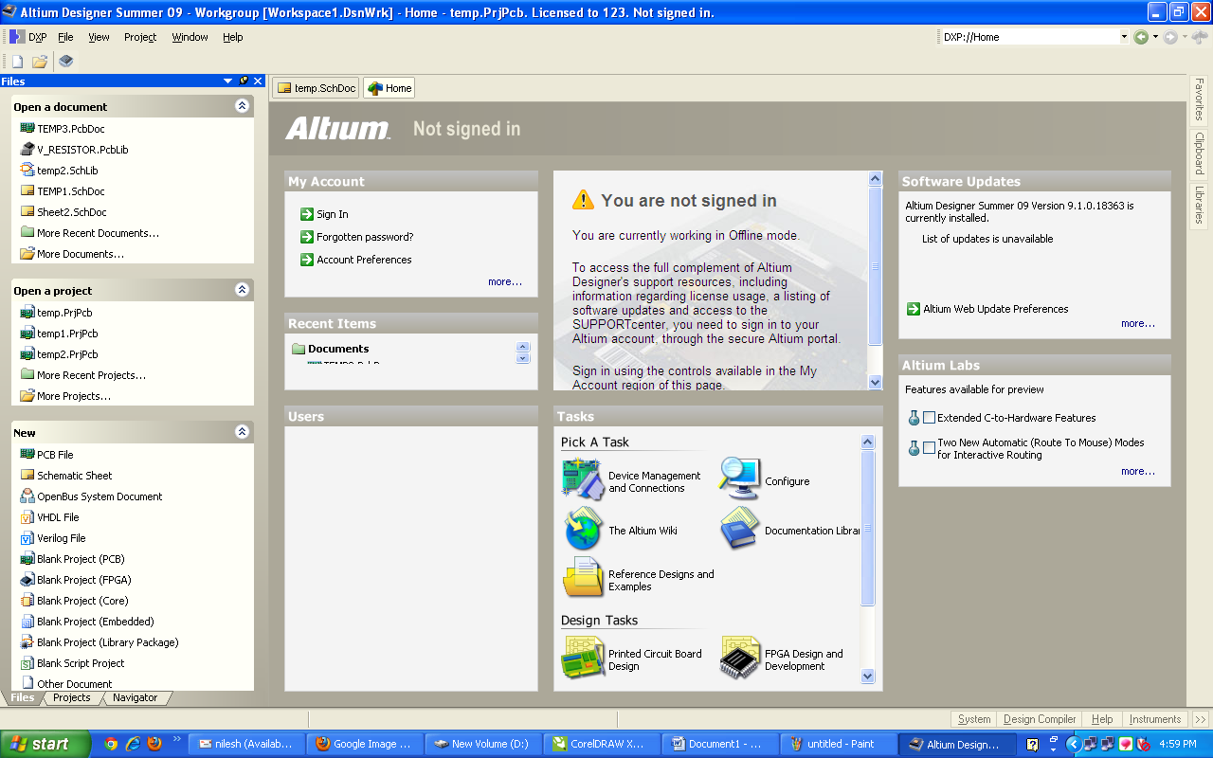
Creating a New PCB Project
START THE ALTIUM DESIGNER BY DOUBLE CLIKING ON ICON.

Slide 11
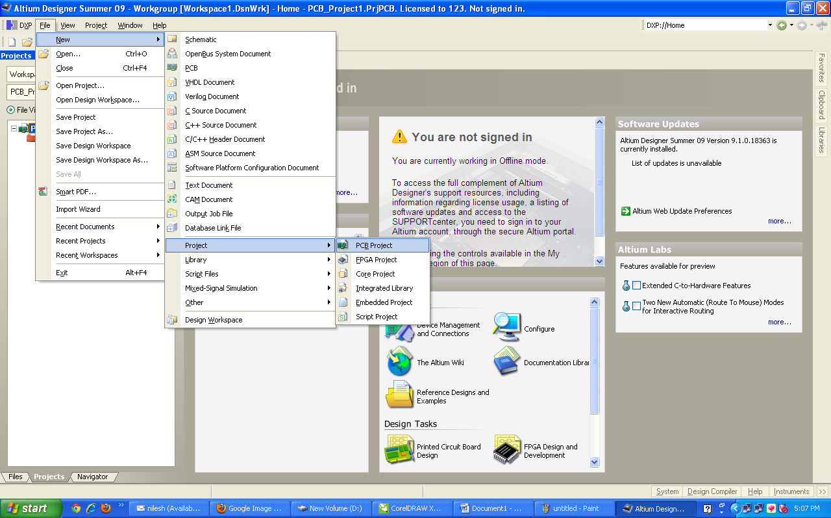
Creating a New PCB Project
Select File»New»Project»PCB Project from the menus

Slide 12
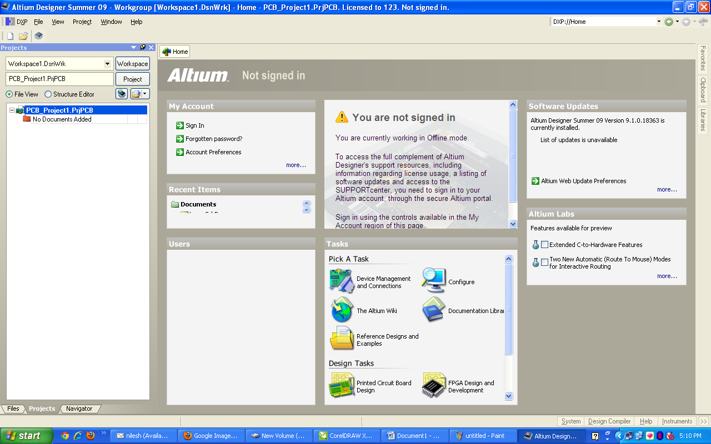
Creating a New PCB Project
The Projects panel will open, displaying the new project file, PCB_Project1.PrjPCB (with no documents added).

Slide 13
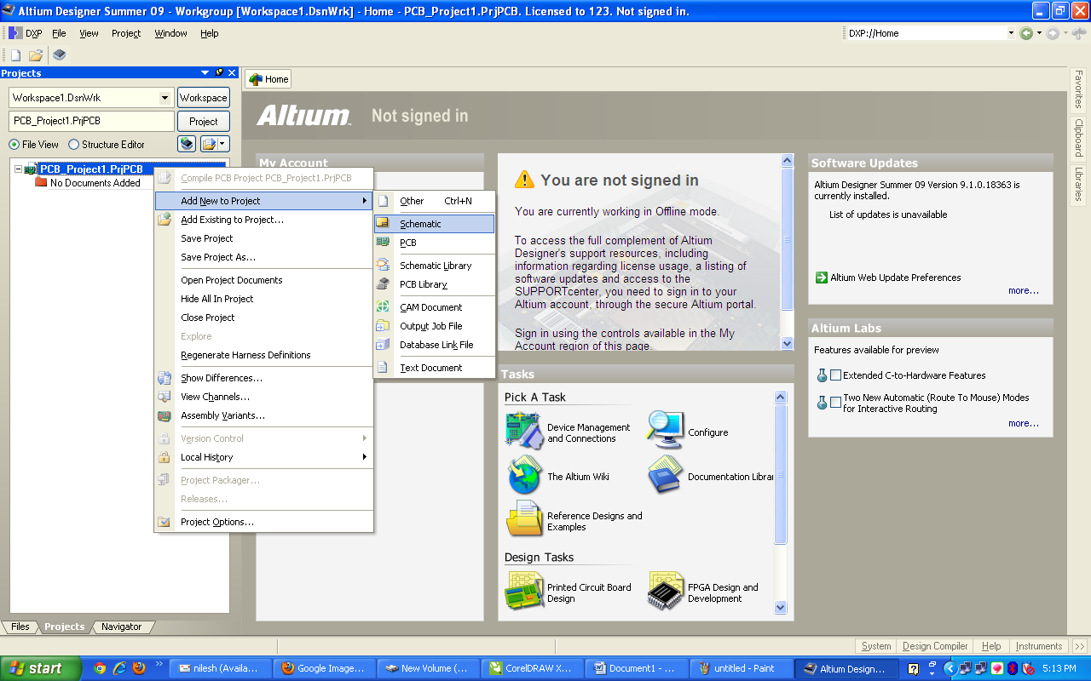
Creating a New Schematic Sheet
THERE IS NO FILES IN THE PROJECT.
SO WE HAVE TO ADD FIRST THE SCHEMETIC FILE TO DRAW CIRCIUIT.

Slide 14
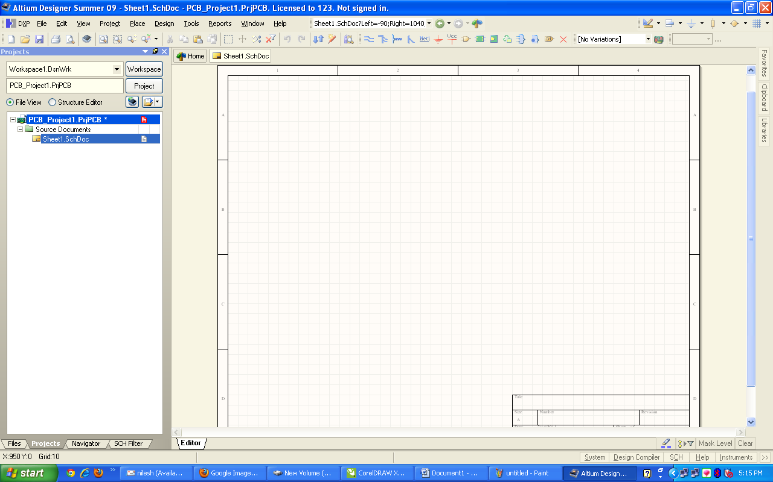
Creating a New Schematic Sheet
THEN YOU CAN SEE THE PAGE LIKE GINVEN BELOW.

Slide 15
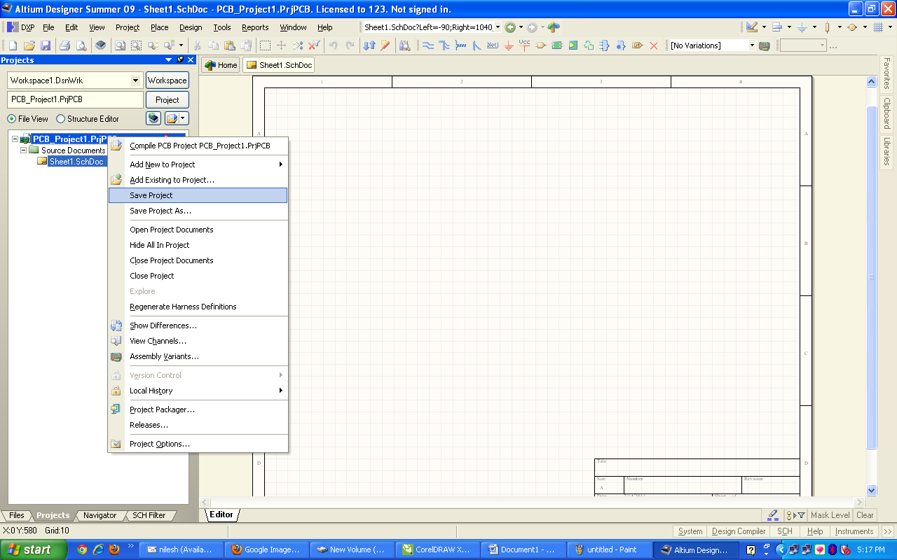
Creating a New Schematic Sheet
NOW MAKE ONE NEW FOLDER AS PER UR REQUIRED NAME IN D OR E DRIVE TO SAVE THE PROJECT.
NOW SAVE THE PROJECT AS GIVEN BELOW.

Slide 16
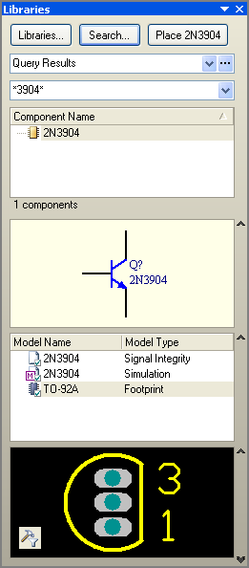
Creating a New Schematic Sheet
WE CAN GET ALL THE REQUIRED COMPONENT AND CONNECTORS FROM THE LIBRERIES GIVEN IN THE
RIGHT SIDE OF UR SCHEMETIC DIAGRAM.
NOW OPEN THE LIBRARAY TO ADD DIFF COMPONENTS AND CONNECTORS AS REQUIRED.

Slide 17
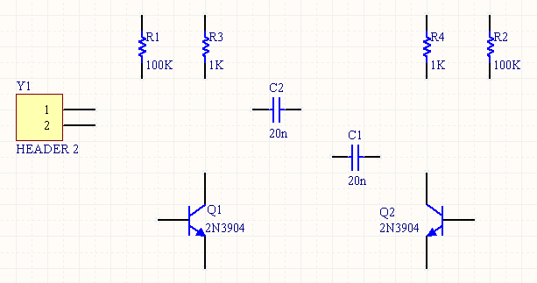
Creating a New Schematic Sheet
TO ADD COMPONENT FROM THE LIST JUST DRAG IT FROM LIST AND DROP IT TO SCHEMETIC DIAGRAM.
ADD REQUIRED CONNECTORS LIKE IC OR MALE FEMALE CONNECTORS FROM THE LIST.

Slide 18
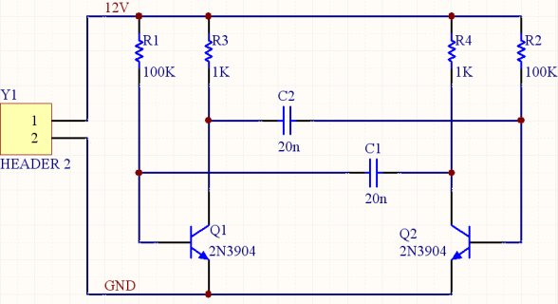
Creating a New Schematic Sheet
NOW FIRST GIVE THE NAMES TO THE ALL THE COMPONENT AND CONNECTORS AT THE PLACE P? D? R?.
YOU CAN GIVE NAME AS R1 R2 R3… D1 D2 D3… IC1 IC2 IC3…
NOW TO CONNECT THE COMPONENT AND CONNECTOR TAKE PLACE WIRE AND CONNECT AS PER REQUIRMENT.
ALSO SAVE THE PROJECT FILE.

Slide 19
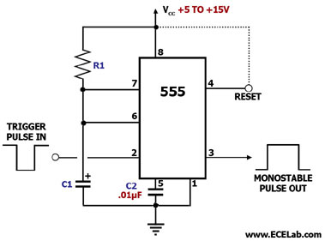
Make a Schematic for given circuit

Slide 20
